Slide 1
Collaborative Manipulation Pipeline
Outline
Overview
Implementation details
Current demonstrations
Pros and Cons
Next steps

Slide 2
SBPL Demo Framework Motivation and Design Goals
Current State:
Demos are time consuming and have to be made from scratch
Past demos largely cannot be recreated or reused
Design Goals:
To enable multi-robot manipulation tasks (quadcopter projects out of scope)
Allow researchers to quickly script demos that feature their area of interest
Maintain demonstration code that can be reused
Allow independent development on robots on differing platforms

Slide 3
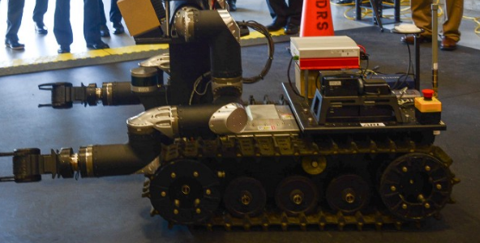

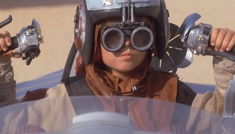
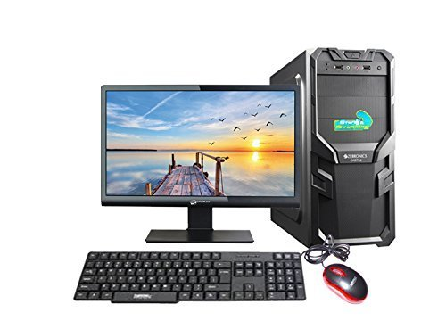

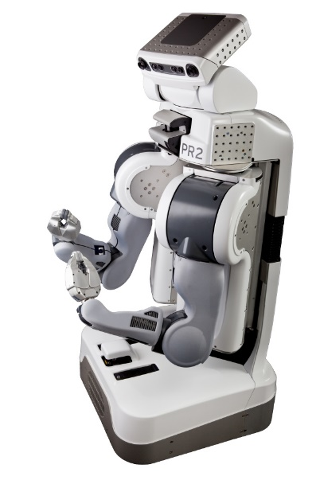
ROS Architecture
Tatooine
Indigo
Roman
Indigo
roslaunch sbpl_multimaster sbpl_hub.launch
Rocon Hub (Redis Server)
@Dagobah:6830
Dagobah
Indigo
Groovy ⬄ Indigo Moveit Interface
Alan1
Groovy
PR2 Local Master
Actions:
Move_base
Move_arm
Torso_controller
Point_head
TF_lookup
Gripper Cmds
Topics:
Raw sensor data
SBPL LAN
Commander Local Master
Action clients
Service calls
Read topics
Runs State Machine
TF bookkeeping between robots
Rocon Gateway
Rocon Gateway
roslaunch sbpl_multimaster alan1_gateway.launch
roslaunch sbpl_multimaster dagobah_gateway.launch

Slide 4
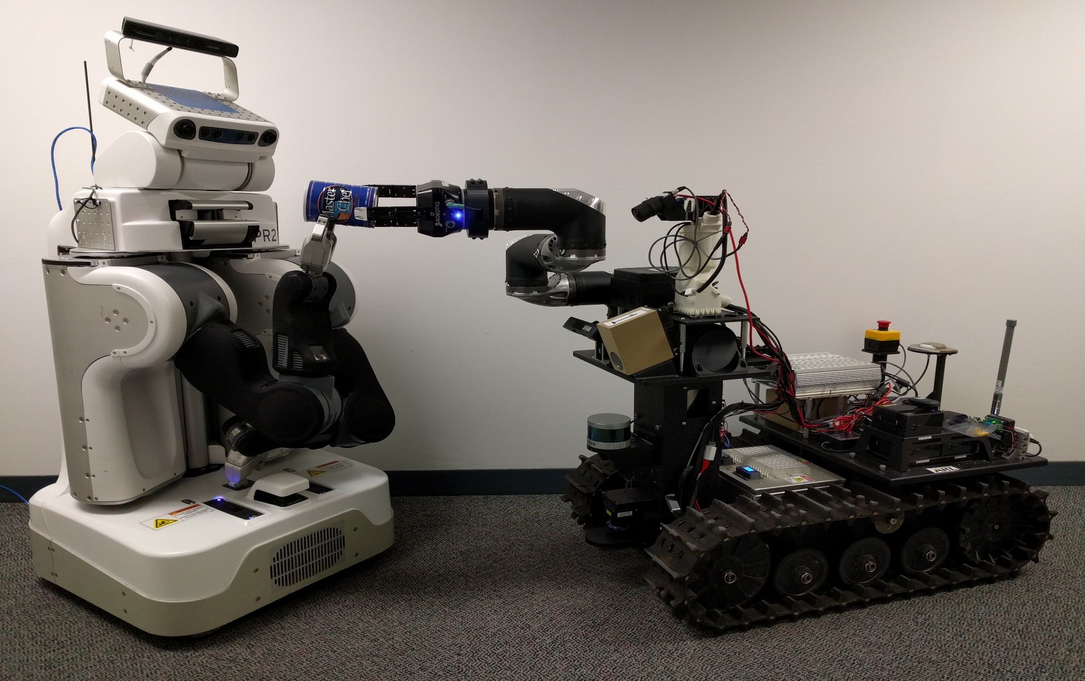
Kinect
Point_head action
Move_arm SBPL
AR Tag Detection
PointGrey BlackFly
(unused)
Move_arm OMPL
Gripper Actions
Move_arm SBPL (TODO)
Asus Xtion + Tilt servo
Move_base
No Navigation
Move_base SBPL (TODO)

Slide 5
Implementation details
Sbpl_demos
SBPL_multimaster
Groovy_indigo_moveit_
wrapper
ROS package to contain python-based scripting utilities
Robot-specific action clients and services
State machine (python based)
AR Tag functions
Status:
Functional, continued development
https://github.com/sbpl/sbpl_demos
ROS package to manage the Rocon setup within lab
Rocon configuration generator
Gateway launch files
Rocon hub launch
Status:
Completed
https://github.com/sbpl/sbpl_multimaster
ROS package to manage PR2 from Indigo Moveit
Custom message packages that match Groovy MD5sums
I2g_follow_joint_trajectory action server
Status:
Completed
https://github.com/abrinkmacmu/groovy_indigo_moveit_wrapper

Slide 6
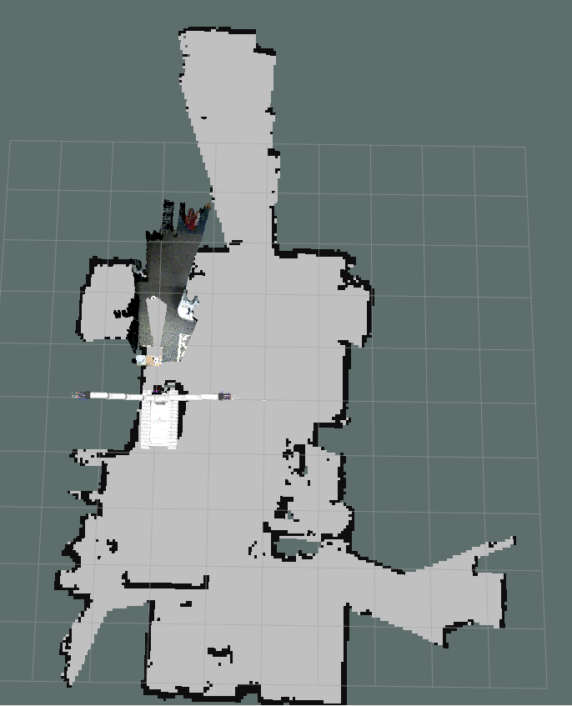
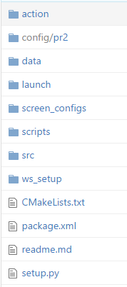
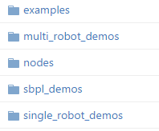
Sbpl_demos
- Lab maps
-Example usage code, not clean but may help users
-
-
Convention for finding python scripts “from sbpl_demos.pr2_helpers import GripperCommander”
- Installation instructions
- Pr2 and Roman details

Slide 7
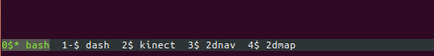
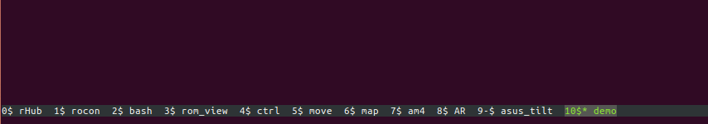
Screen Configurations
One Screen config per machine Aids startup time and guides users to correct launches and scripts
Contained in spbl_demos/screen_configs
Tatooine
Indigo
Alan1
Groovy
Dagobah
Indigo
Roman
Indigo

Slide 8
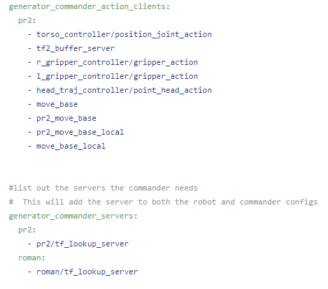
Sbpl_multimaster
The user should only have to modify one file
Modify config/gateway_topics.yaml to suit your needs
Launch the generate_multimaster_configs.yaml to create <machine>_gateway.launch files for all machines in the network
Push the changes to the other machines
Rerun the <machine>_gateway.launch files
Does require manual configuration of each machine after change
could be addressed by installing workspaces
Config/gateway_topics.yaml

Slide 9
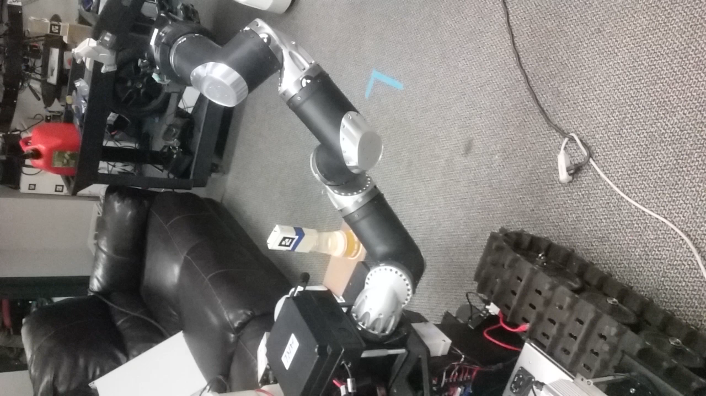
Single Robot: Roman Demo sbpl_demos/scripts/single_robot_demos
Use AR pose detection to command a simple sequence of Arm motions
Required:
Roman and Commander (Dagobah)
AR Tagged item
Instructions:
Place AR tag in view of the Asus, confirm AR pose estimation in Rviz
The pre-grasp and post grasp are computed on the right side of the tag, so ensure the Roman can reasonably reach the tag
Once supporting servers are running, execute roman_grasp_test.py
Improvement Ideas:
Instead of just one grasp approach to the AR item, consider many (top down, 90 deg intervals, or RPY randomization
Include collision object for picking surface and attached collision object

Slide 10
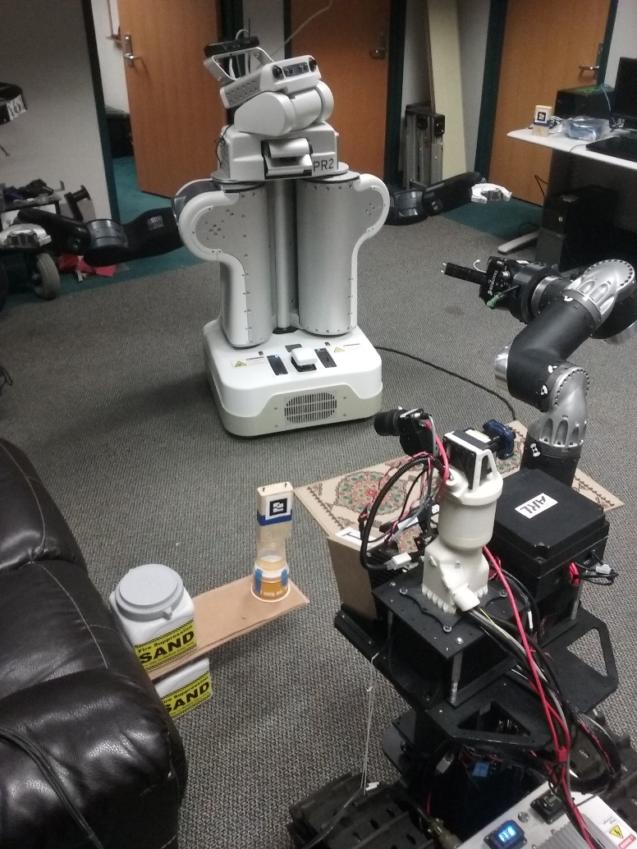
Multi Robot: Hardcoded handoff sbpl_demos/scripts/multi_robot_demos
Use AR pose detection to command a simple sequence of coordinated arm motions across 2 robots
Required:
Roman and Commander (Dagobah)
PR2 and Commander (Tatooine)
AR Tagged item
Instructions:
Place AR tag in view of the Asus, confirm AR pose estimation in Rviz
The pre-grasp and post grasp are computed on the right side of the tag, so ensure the Roman can reasonably reach the tag
Once supporting servers are running, execute roman_pr2_hardcoded_handoff.py
Improvement Ideas:
Coordinate collision objects between robots

Slide 11
Pain Points Strengths
Roman elmo/ethercat driver initialization (ongoing)
Unhelpful error message:
*** ERROR (12) : Erroroneous response when reading SO
System restarts have been the only way I know to clear this issue, sometimes many times
Rocon networking (intermittent)
Most of the time it functions properly but occasionally subscribed topics do not appear
Number of subscribers do not increase over the network, so beware of code that requires >= 1 subscriber to begin
System Complexity (solved)
Shear number of computers and electronics to manage adds significant non-value overhead
Computers total: 9 (5 – roman, 4 – PR2), LAN configuration, Roman electronics
Rocon Solves Groovy/Indigo problem
Barrier to entry should be low for PR2 development
Pr2 Navigation, actions, and Arm Planning
Roman Arm Planning
Lab network is robust across Pr2 and Roman
AR tag pose estimation is robust

Slide 12
Next Steps
Demos
Exploit more of the PR2’s features in multi-robot demo (Alex)
Pass objects back and forth between robots indefinitely (Alex)
Features
Explore moveit sensor manager for real-time collision obstacle generation (Tae-hyung)
Improve arbitrarily located AR tag grasping (Alex)
Collision object sharing between robots (Alex)
Other-robot collision modelling (Alex)
Get SBPL arm planner packages in sbpl_demos setup configurations (Sung)
MRSD Handoff Development
An MRSD team of 5 people will be taking this system to create a more robust handoff system

